Slide 1

Viva Connections & SharePoint Framework Bi-weekly sync
aka.ms/m365pnp
Your host in this call: Patrick Rodgers
Call begins at 7:00 AM PT / 3:00 PM GMT
June 30, 2022
Microsoft 365 PnP Team

Slide 2
Viva Connections & SharePoint Framework Bi-weekly sync
aka.ms/m365pnp
Your host in this call: Patrick Rodgers
June 30, 2022
Microsoft 365 PnP Team

Slide 3


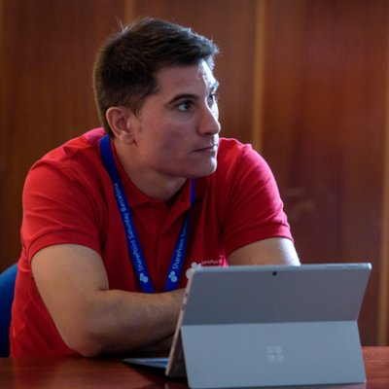


Agenda
Latest update on SharePoint Framework
Patterns and Practices Updates
PnPjs
CLI for Microsoft 365
Reusable PnP SPFx controls
New Community Samples
Picture time with Together Mode!
Demos
Arun Kumar Perumal – Accordion Tabs with Richtext
Luis Mañez - User Profile Awards using MS Graph
Marcin Wojciechowski – Adaptive Card Extensions strategy pattern for multi-action QuickView

Slide 4
Opportunities to Participate in PnP SPFx / JS SIG
SPFx Demo
@pnp Demo
Contribute on GitHub
Provide Feedback
Web Part
Application Customizer
Provisioning
Anything you create!
PnPjs
CLI for Microsoft 365
SPFx Reusable Controls
SPFx Community Yeoman
Report Issues
Submit Pull Requests
Help with issues/questions
How are the calls?
Documentation needs?
Where can we help?
Positive is OK too!
Great opportunity to get visibility for you or your company. Demo sample or explain how you extend or customize SharePoint Online with live demo in your projects. Reach out to team for volunteering.
Request a demo spot on the call
https://aka.ms/m365pnp/request/demo

Slide 5
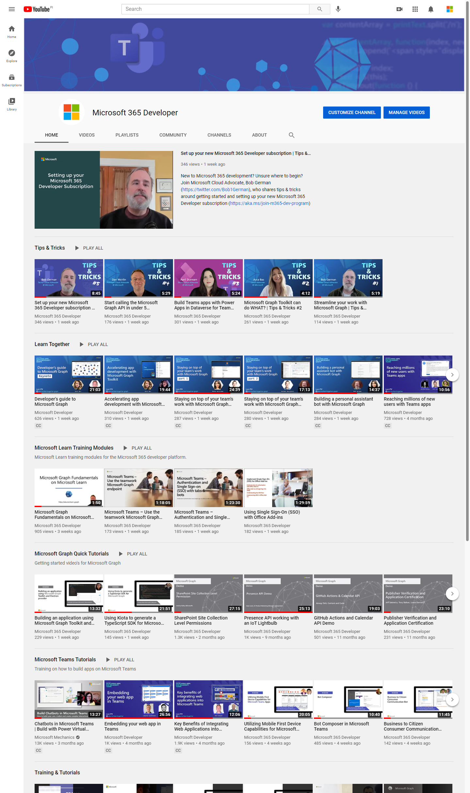
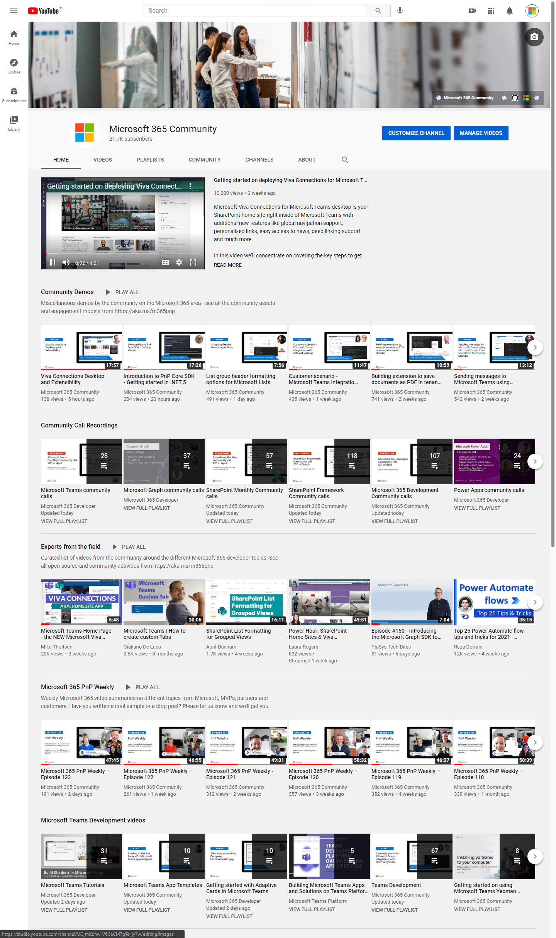
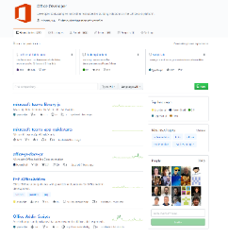
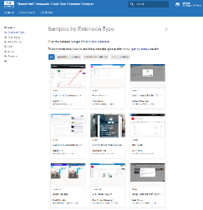
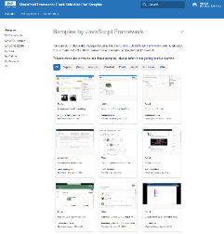
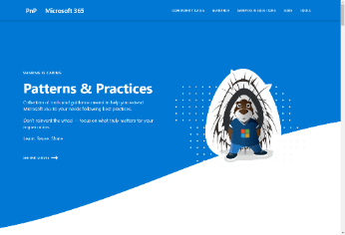
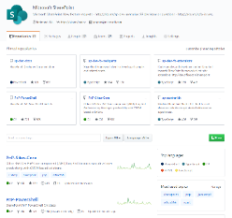
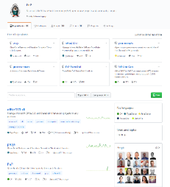
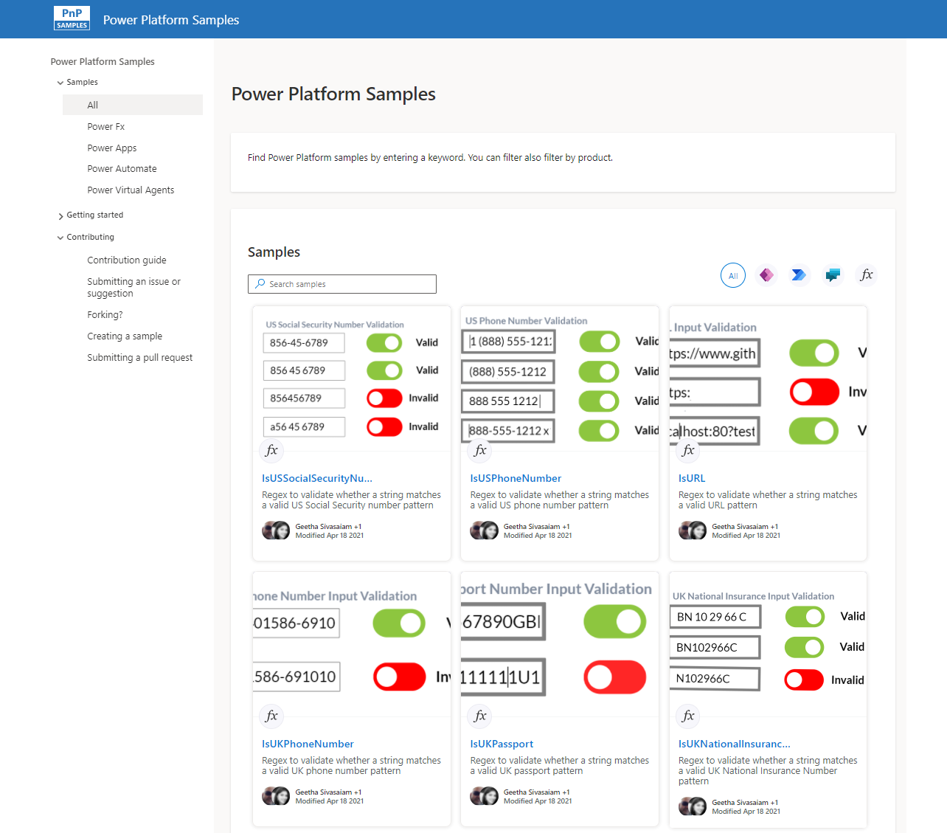
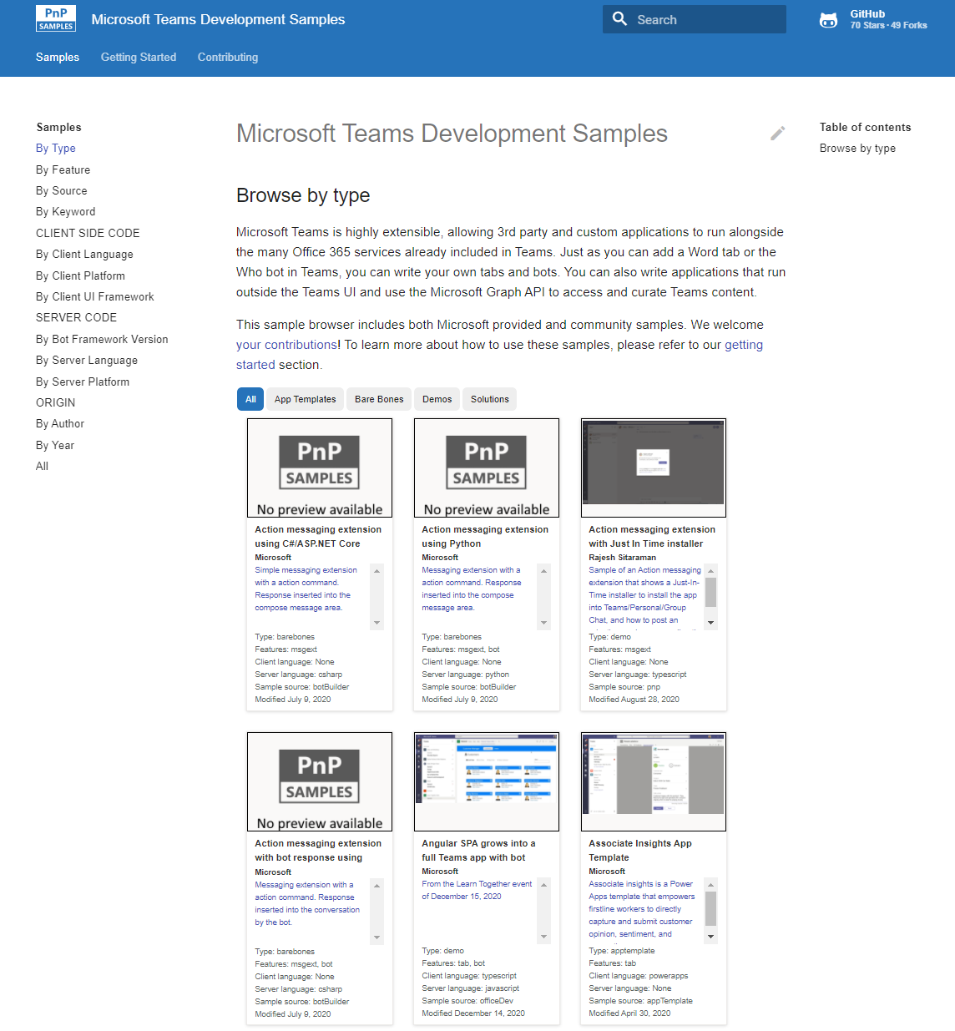
Microsoft 365 developer videos
Microsoft 365 community videos
Open-source
Sample galleries
Open-source initiatives and samples
aka.ms/m365devyoutube
aka.ms/m365/videos
github.com/pnp
github.com/officedev
github.com/microsoftgraph
github.com/sharepoint
aka.ms/m365/samples
aka.ms/teams-samples
aka.ms/spfx-webparts
aka.ms/spfx-aces
aka.ms/powerplatform-samples
aka.ms/spfx-extensions
aka.ms/list-formatting
aka.ms/m365/community
@Microsoft365Dev | @m365pnp
One URL to rule them all…

Slide 6
Microsoft 365 developer community calls
Microsoft 365 platform (weekly) https://aka.ms/m365-dev-call
(Notice. This call is on a summer break between July 1st and 31st of August 2022)
Adaptive Cards https://aka.ms/adaptivecardscommunitycall
Microsoft identity platform https://aka.ms/IDDevCommunityCalendar
Office Add-ins https://aka.ms/officeaddinscommunitycall
Power Platform https://aka.ms/PowerPlatformCommunityCall
Microsoft 365 and Power Platform community (bi-weekly) https://aka.ms/m365-dev-sig
Viva Connections & SharePoint Framework (bi-weekly) https://aka.ms/spfx-call
Download recurrent invites from
https://aka.ms/m365/calls
Notes:
m365-dev-sig

Slide 7

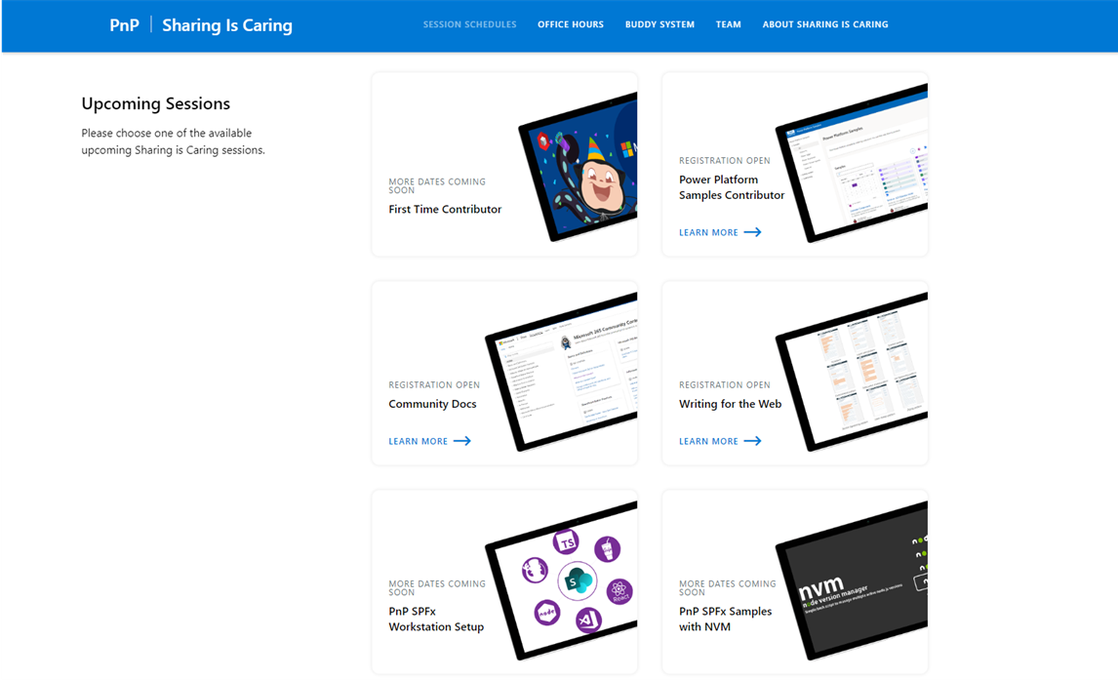
GUIDANCE
Learn how to get started in the open-source PnP community!
Upcoming Sessions:
First-time contributor
Community docs
Using PnP SPFx samples w/ NVM
SPFx developer workstation setup
More than code with VS Code
First-time presenter
M365 Maturity Model Practitioners
Power Platform Samples Contributor
Writing for the Web
Power Platform – Power Pages
JULY DATES!!!
COMING SOON!!!
https://aka.ms/sharing-is-caring
Notes:
25 Total attendees, 16 attendees who attended both First-Time Contributors and Community Docs sessions.

Slide 8





COMMUNITY
PnP Recognition Program
Showcase your contributions
Powered by Credly
More achievement levels coming soon
https://aka.ms/m365pnp-recognition
Notes:
25 Total attendees, 16 attendees who attended both First-Time Contributors and Community Docs sessions.

Slide 9
SharePoint Framework Latest from Microsoft engineering for Microsoft Viva, Microsoft Teams and SharePoint extensibility

Slide 10
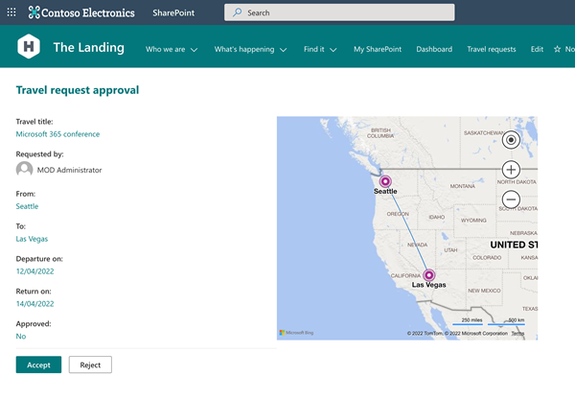
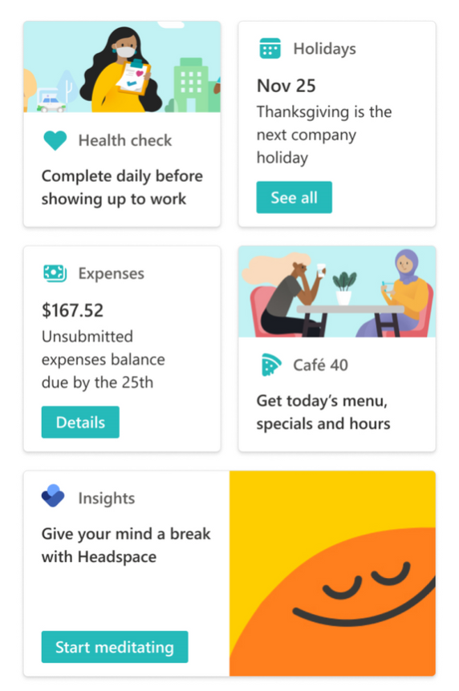
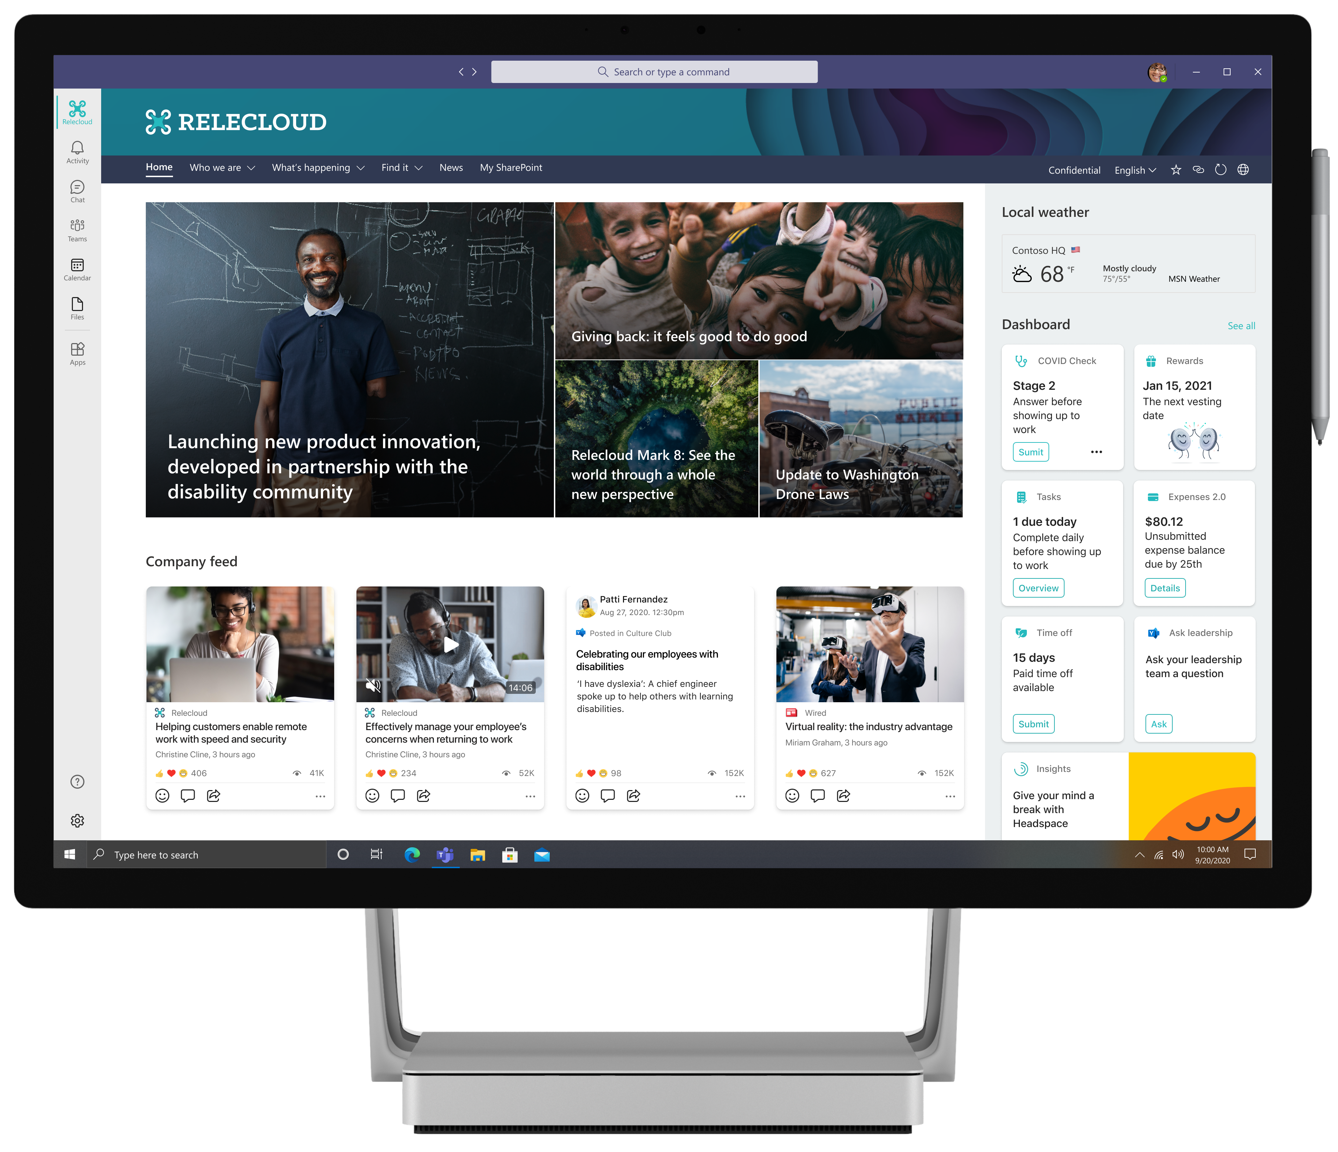




List and library form extensibility included!
RELEASE
SharePoint Framework 1.15 now available!
New updated version of SharePoint Framework is now available with updated features for Microsoft Teams, Microsoft Viva and SharePoint Online
npm install -g @microsoft/generator-sharepoint
Notes:
Dan’s slide

Slide 11
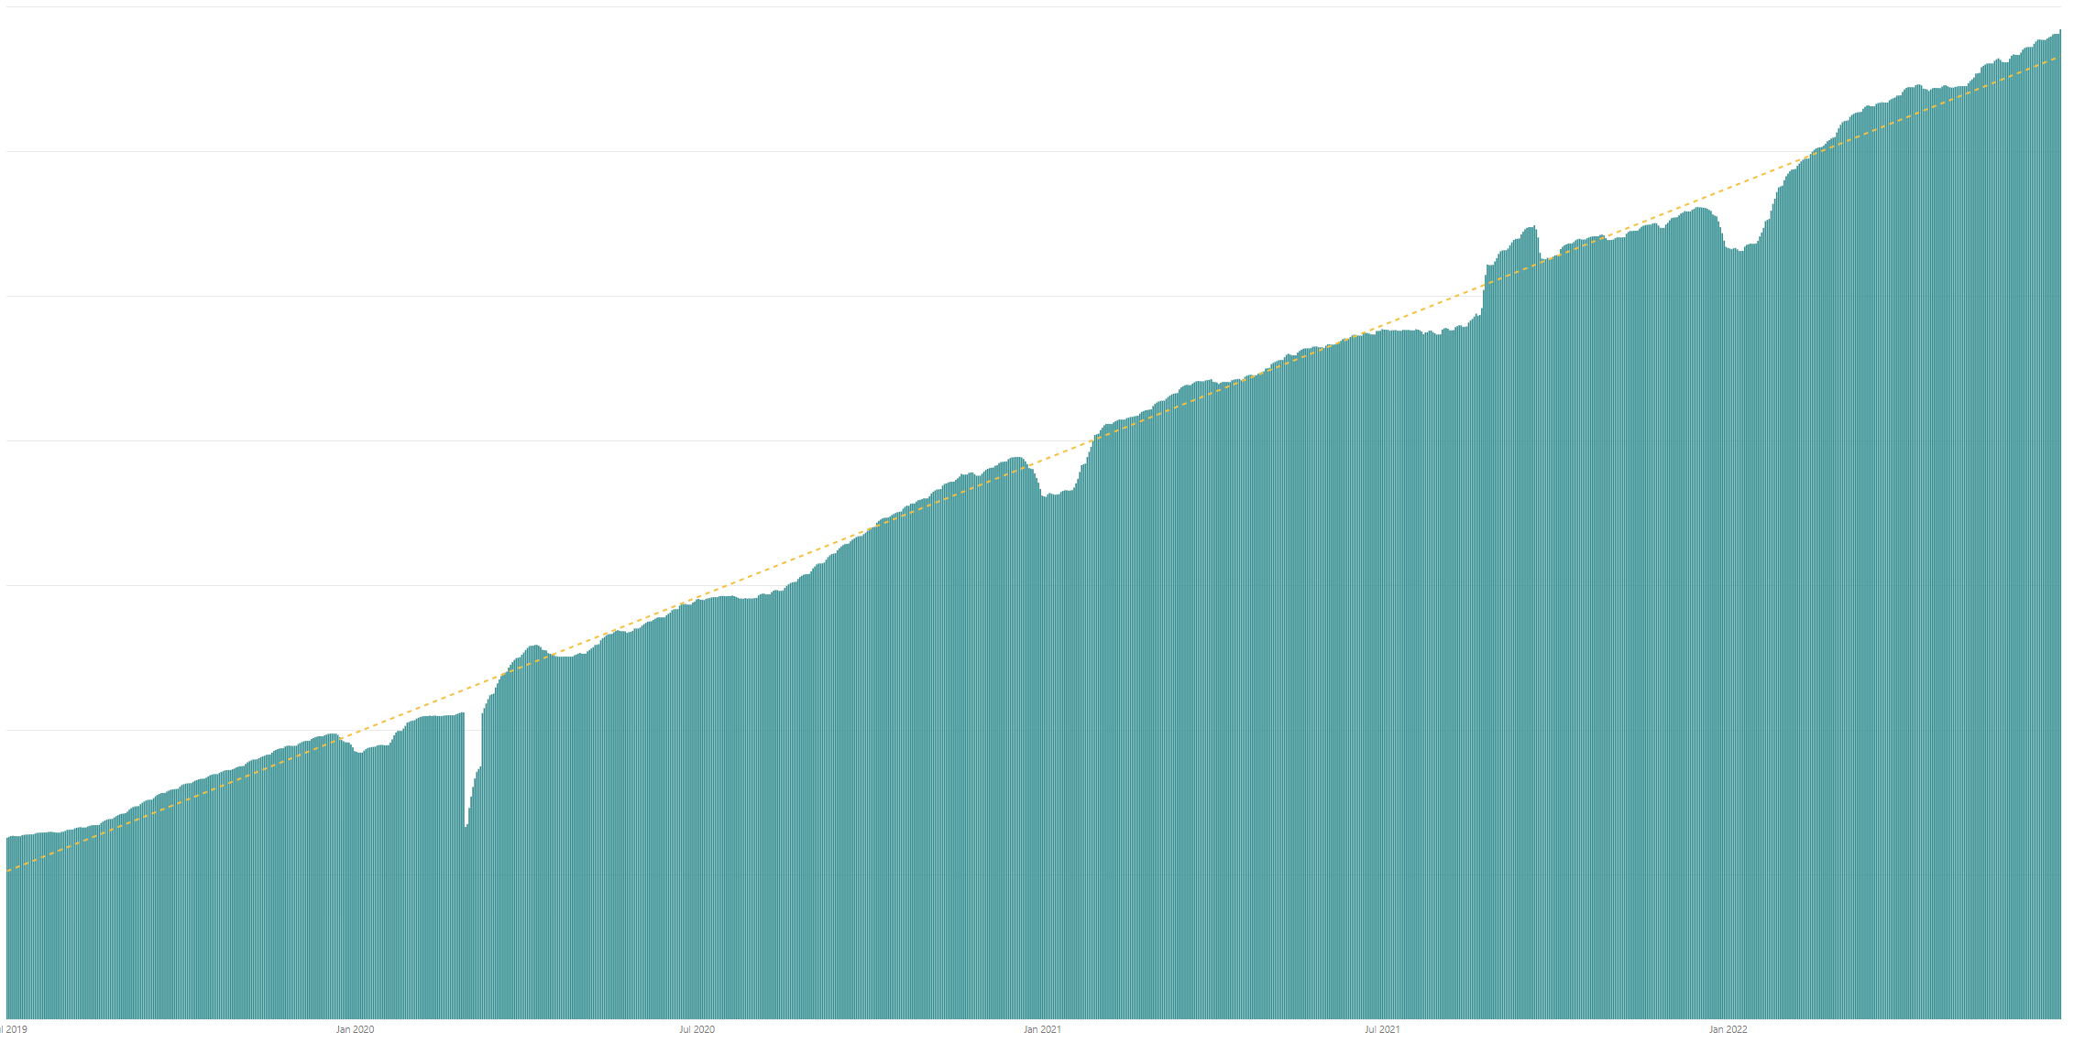

Rolling 28 days active users (MAU) for custom SharePoint Framework components in M365 There are currently tens of millions of monthly active users for customer and partner created SharePoint Framework components in Microsoft 365
Jul 2019
Jan 2020
Jul 2022
Jan 2021
Jul 2021
Jan 2022

Slide 12




The Road Ahead – SPFx roadmap
1.15 – Released 2 weeks ago
New Action types for media and geolocation – Tutorial just published
Support for Microsoft Graph SDK V3
ESLint support
Support for TypeScript V4.5
Support for Teams SDK v1.12.1
Bug fixes and adjustments based on GitHub issues
New customizers for add and edit list / library forms
Nodejs v16 support
1.16 preview in late July/early August
Bots Powered Adaptive Card Extensions (Beta)**
Enable Service Principal Registration in app acquisition flow
Adaptive Card Extensions card view caching
Adaptive Card Extensions Error Handler Method
… and more… 🚀
1.16 General Availability in September
1.17 ETA in December/January
and more across Microsoft Viva, Microsoft Teams and SharePoint

Slide 13

PnPjs Client-Side Libraries

Slide 14
























PnPjs Client-Side Libraries
Version 3.5 to be released July 8th
General documentation updates
Fix for WebPartContext typing change in SPFx 1.15
Added Lists, Columns, Content Types to Graph
Beta-2 release of cancellable fetch calls
Tenant Admin support with new package (sp-admin)
Don’t forget about the nightly builds
npm install @pnp/sp@v3nightly --save
Docs: https://pnp.github.io/pnpjs/ @m365pnpjs on twitter

Slide 15
CLI for Microsoft 365

Slide 16
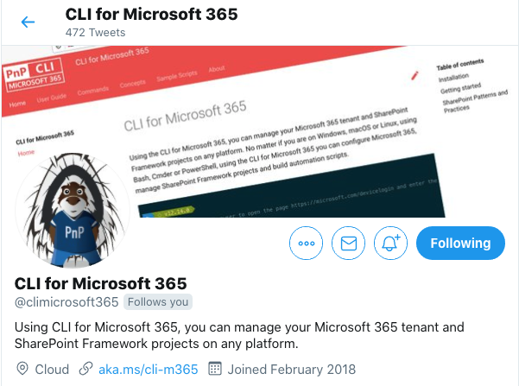
CLI for Microsoft 365
New v5.4 with:
Support for upgrading SPFx projects to v1.15.0
Removing Planner tasks and adding task checklist items
Simplified working with Planner buckets
Improved retrieving list- and site columns
Removing role definitions in SharePoint sites
Retrieving information about event receivers
Support for creating list views using a query
...and more!
Install v5.4:
npm install -g @pnp/cli-microsoft365@latest
docker run --rm –it m365pnp/cli-microsoft365:latest
Release notes:
https://pnp.github.io/cli-microsoft365/about/release-notes/#v540
@climicrosoft365 #CLIMicrosoft365 on Twitter
📖 aka.ms/cli-m365
🗣 github.com/pnp/cli-microsoft365/discussions
Notes:
Summary
Support for upgrading projects to the latest version of SPFx
New command and enhancements across Azure AD, SharePoint Online and Planner as well as bug fixes
Checkout the release announcement and notes for full coverage of this month’s release
To get the latest version, you can install directly from npm or as an alternative you can use our Docker image to run CLI in a container which comes pre-loaded with various tools and utilities
Follow us on Twitter for the latest announcements using our handle @climicrosoft365
If you have any feedback or ideas for new features, then please checkout the GitHub repo, raise an issue or start a discussion, we would love to hear from you.
📣 CLI for Microsoft 365 v5.4 (pnp.github.io)
📝 Release notes - CLI for Microsoft 365 (pnp.github.io)
⬆️ project upgrade - CLI for Microsoft 365 (pnp.github.io)
📦 @pnp/cli-microsoft365 - npm (npmjs.com)
🐳 Run CLI in a Docker Container - CLI for Microsoft 365 (pnp.github.io)
💬 CLI for Microsoft 365 (@climicrosoft365) / Twitter
💻 pnp/cli-microsoft365: Manage Microsoft 365 and SharePoint Framework projects on any platform (github.com)

Slide 17
SPFx Reusable Components

Slide 18
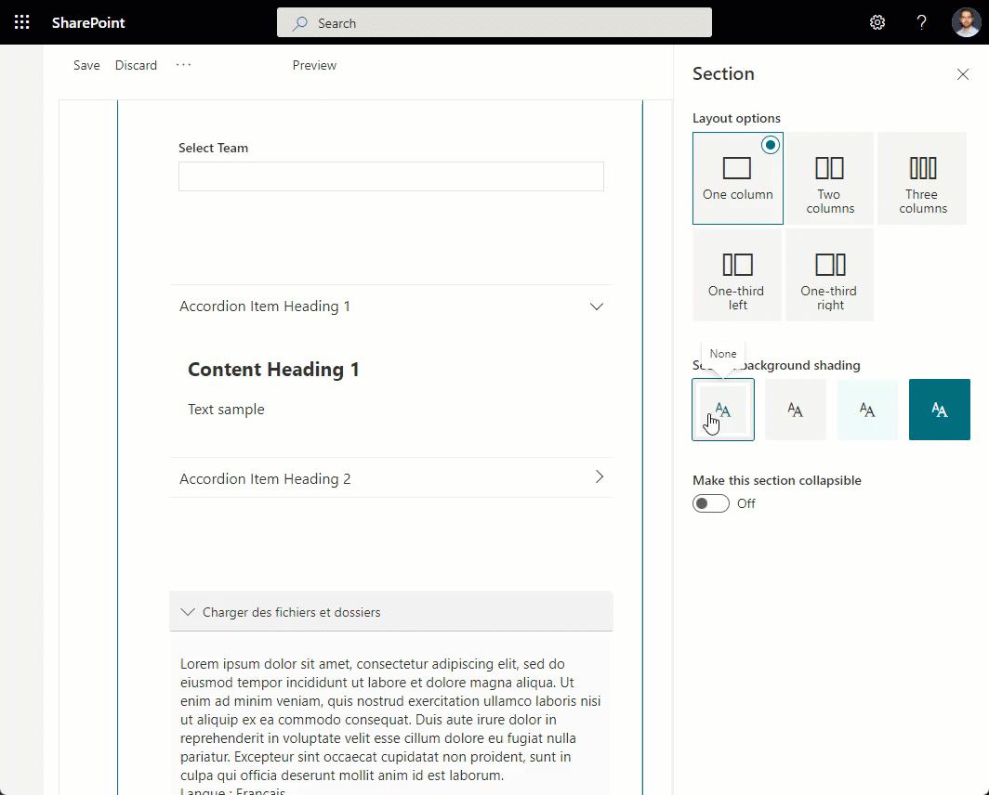
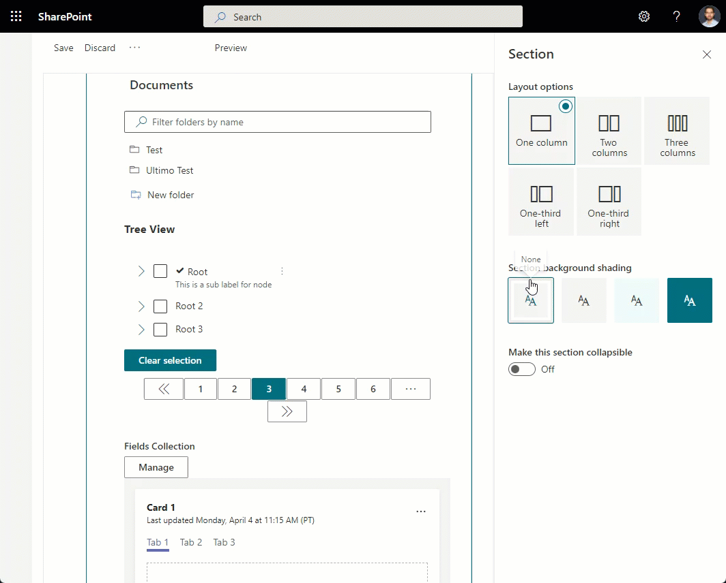
Reusable SPFx Controls
React Controls – 3.8.1
Fix: LivePersona not showing card on hover
Release notes: https://pnp.github.io/sp-dev-fx-controls-react/about/release-notes/
React Property Controls – 3.7.0
PropertyFieldListPicker: ability to provide content type id
PropertyFieldColorPicker: provide preview of the selected color
Release notes: https://pnp.github.io/sp-dev-fx-property-controls/about/release-notes/
Special thanks to our contributors: Alexander Kleshcheov, Andreas Omayrat, brianpmccullough, Christophe Humbert, Fabio Franzini, Gautam Sheth, Joel Lopes, Milan Holemans, Patrik Hellgren, Ravichandran Krishnasamy, Rico van de Ven, Russell gove.
More information:
https://sharepoint.github.io/sp-dev-fx-property-controls https://sharepoint.github.io/sp-dev-fx-controls-react
Twitter: @M365PnPControls

Slide 19
PnP Modern Search

Slide 20
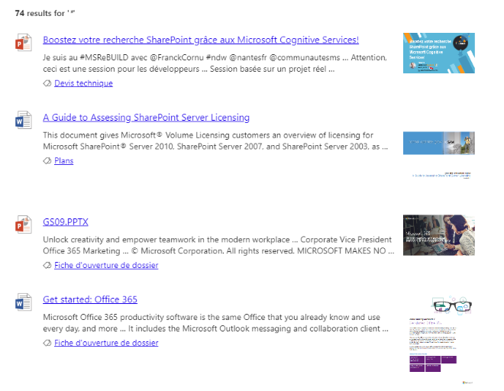

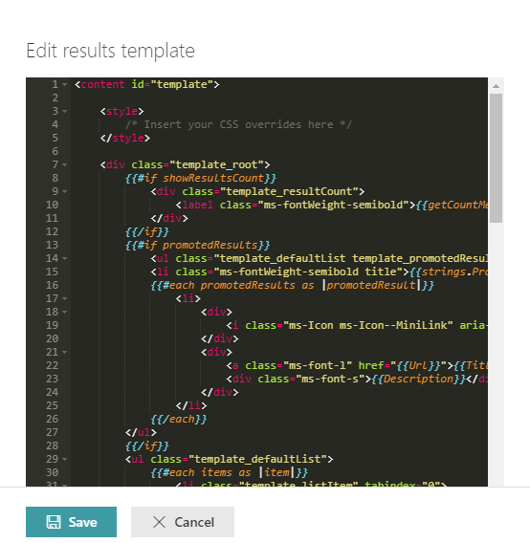
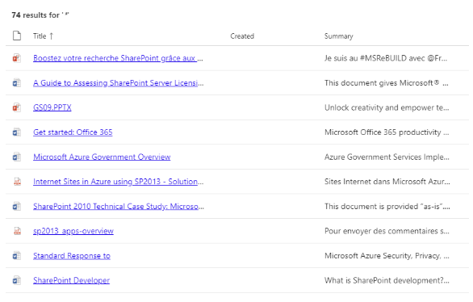


PnP Modern Search
http://aka.ms/pnp-search
Building modern Search experiences with flexible web parts
v4.7.0-beta – June 2022 release
https://github.com/microsoft-search/pnp-modern-search/releases/tag/4.7.0-beta
Thank you @d-martins, @bruzie, @rick-brown-slalom, @mrjarbenne, @davemehr for your support
Support for Adaptive Card rendering
See release notes for fixes and new features
v3.23.0 – December 2021 release
https://github.com/microsoft-search/pnp-modern-search/releases
See release notes for fixes and new features
Notes:
https://github.com/microsoft-search/pnp-modern-search

Slide 21

PnP SPFx Samples

Slide 22
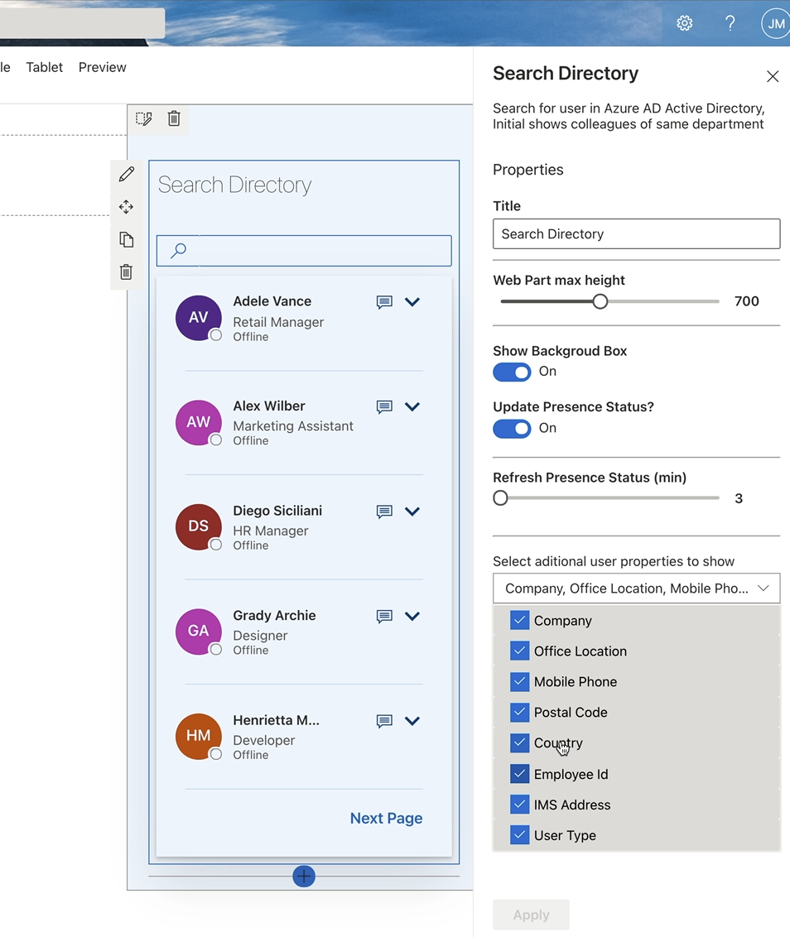
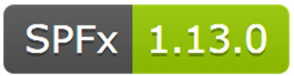
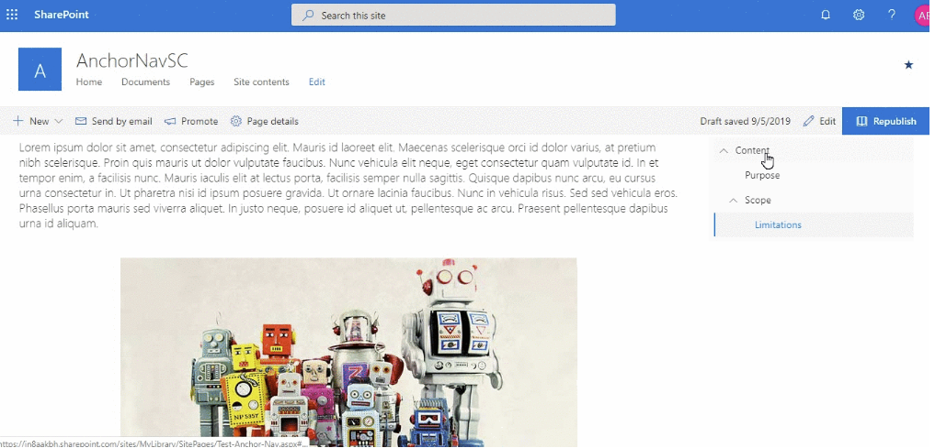
PnP SPFx Samples
PnP SPFx Samples
PnP SPFx Samples
https://aka.ms/spfx-extensions
Contributions welcome
https://aka.ms/spfx-webparts
Page Navigator Jasey Waegebaert | Jwaegebaert
Staff Directory Milan Holemans | milanholemans
Follow Documents André Lage | @aaclage
Notes:
SPFx extensions https://aka.ms/spfx-extensions
NOPE
SPFx web parts https://aka.ms/spfx-webparts
Page Navigator
Jasey Waegebaert | Jwaegebaert Adds the capability to find collapsible section headers and insert them into the navigation
https://github.com/pnp/sp-dev-fx-webparts/tree/main/samples/react-page-navigator
Staff Directory Milan Holemans | milanholemans
Upgraded SPFx version from v1.11.0 to v1.14.0
https://github.com/pnp/sp-dev-fx-webparts/tree/main/samples/react-staffdirectory

Slide 23
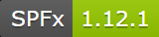
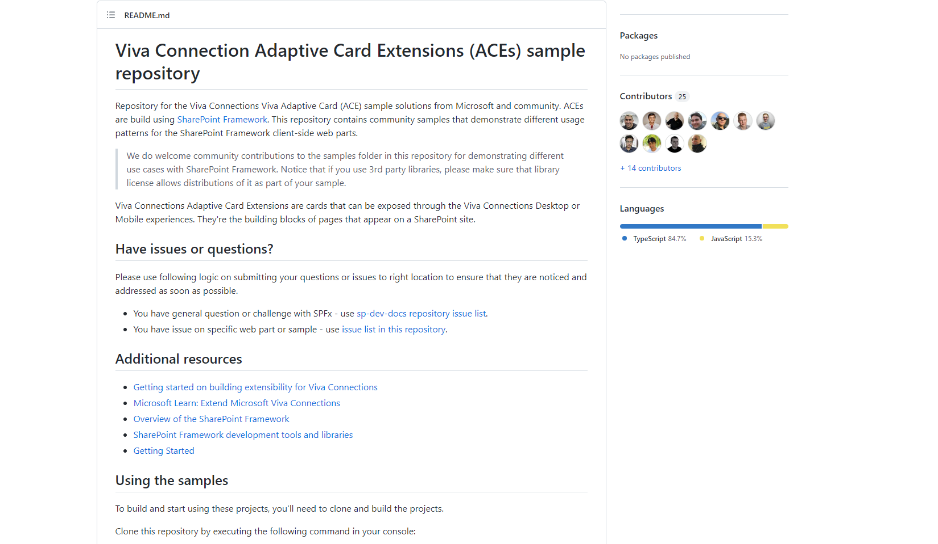
PnP SPFx ACEs
PnP SPFx Samples
PnP SPFx Samples
https://aka.ms/spfx-aces
*** We Love New Samples ***
Sharing is Caring Session
*** Coming Soon ***
Follow Documents André Lage | @aaclage
Notes:
This adaptive card extension sample demonstrate ability to monitor security risks using identity protection graph api from Viva Connection Dashboard
SPFx extensions https://aka.ms/spfx-extensions
Copy/Move Items within Lists Sudharsan Kesavanarayanan | @sudharsank This application customizer will display a command button named Copy/Move Item(s) in all the custom lists. Using this option, the items can be copied or moved from one list to another within the site.
https://github.com/pnp/sp-dev-fx-extensions/tree/main/samples/react-command-copy-move-items
SPFx web parts https://aka.ms/spfx-webparts
Applications Secrets Expiration Aimery Thomas | @a1mery This sample web part shows the list of your applications registered in Azure AD along with their associated client secret/certificate expiration date. https://github.com/pnp/sp-dev-fx-webparts/tree/main/samples/react-graph-app-secret-expiration

Slide 24



Optional picture time!
Video on and we’ll grab a Together Mode pic with those who are willing to do this.
We are together on this as a community!
Let’s all be like Seb?
By enabling your camera for the picture, you grant us permission to share your picture in social media.

Slide 25

DEMO
Accordion Tabs with Richtext – Arun Kumar Perumal
User Profile Awards using MS Graph – Luis Mañez
Adaptive Card Extensions strategy pattern for multi-action QuickView – Marcin Wojciechowski

Slide 26
Thank you
Recording will be available in 24 hours on
Microsoft 365 Community (PnP) YouTube channel
https://aka.ms/M365/videos
(subscribe today)
Follow us on Twitter
@Microsoft365Dev | @M365PnP
Next Viva Connections & SPFx call: July 14th at 07:00am PT
Next M365 General Dev call: July 7th at 07:00am PT
All available community calls from https://aka.ms/m365/calls

Slide 27


aka.ms/m365pnp

